Slide 1
Dimensionality Reduction & Unsupervised learning (K-Means)
Hands-on Machine Learning

Slide 2
Dimensionality reduction

Slide 3
The Curse of Dimensionality
Many machine learning problems involve thousands or even millions of features for each training instance.
Not only do all these features make training extremely slow, but they can also make it much harder to find a good solution.
This problem is often referred to as the curse of dimensionality.
It is possible to reduce the number of features considerably, turning an intractable problem into a tractable one.
Example: in the MNIST images the pixels on the image borders are almost always white, so you could completely drop them.
Notes:
high-resolution photograph, which can result in a very high-dimensional feature space if each pixel or a more abstract feature representation is used
Genomic datasets can have millions of features
Brain Imaging: Neuroimaging data collected from MRI or fMRI scans can have thousands of features

Slide 4
Pros and Cons of Dimensionality Reduction
Advantages:
Speed up training
May filter out some noise and unnecessary details and result in higher performance in some cases
Extremely useful for data visualization
Reduced overfitting
Disadvantages:
Information loss and slightly worse performance
More complex pipelines
Interpretability challenges
Notes:
first try to train your system with the original data before considering using dimensionality reduction
Reducing the number of dimensions down to two (or three) makes it possible to plot a condensed view of a high-dimensional training set on a graph and often gain some important insights by visually detecting patterns, such as clusters.
Moreover, data visualization is essential to communicate your conclusions to people who are not data scientists—in particular, decision makers who will use your results.

Slide 5
1.
Main Approaches for Dimensionality Reduction

Slide 6
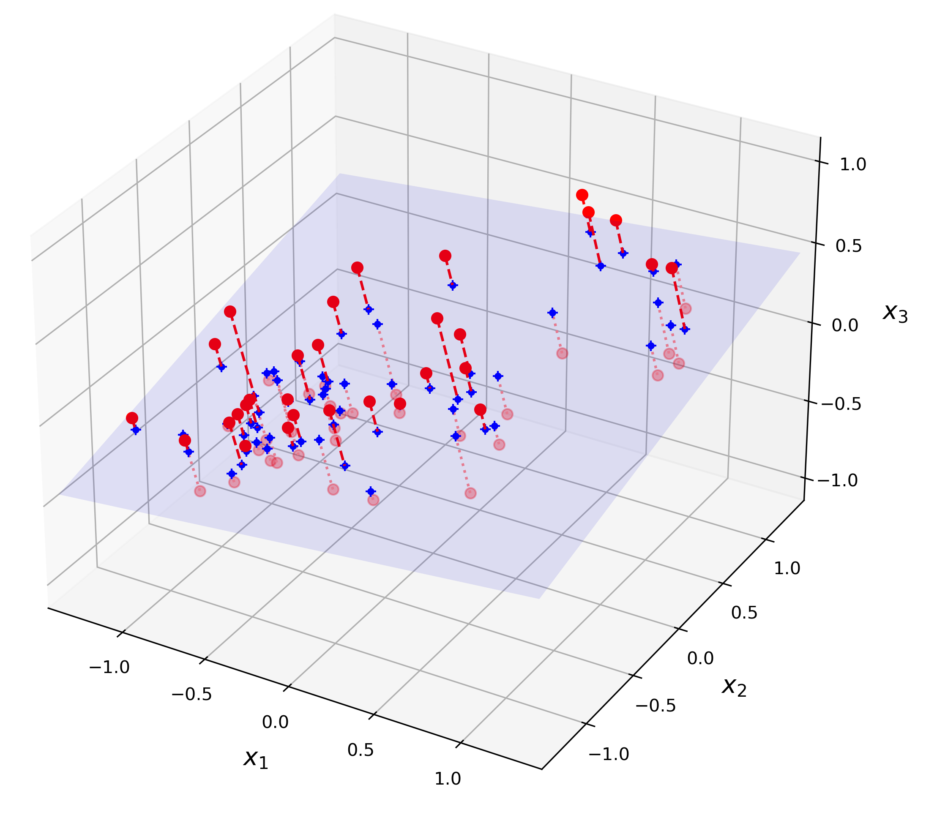
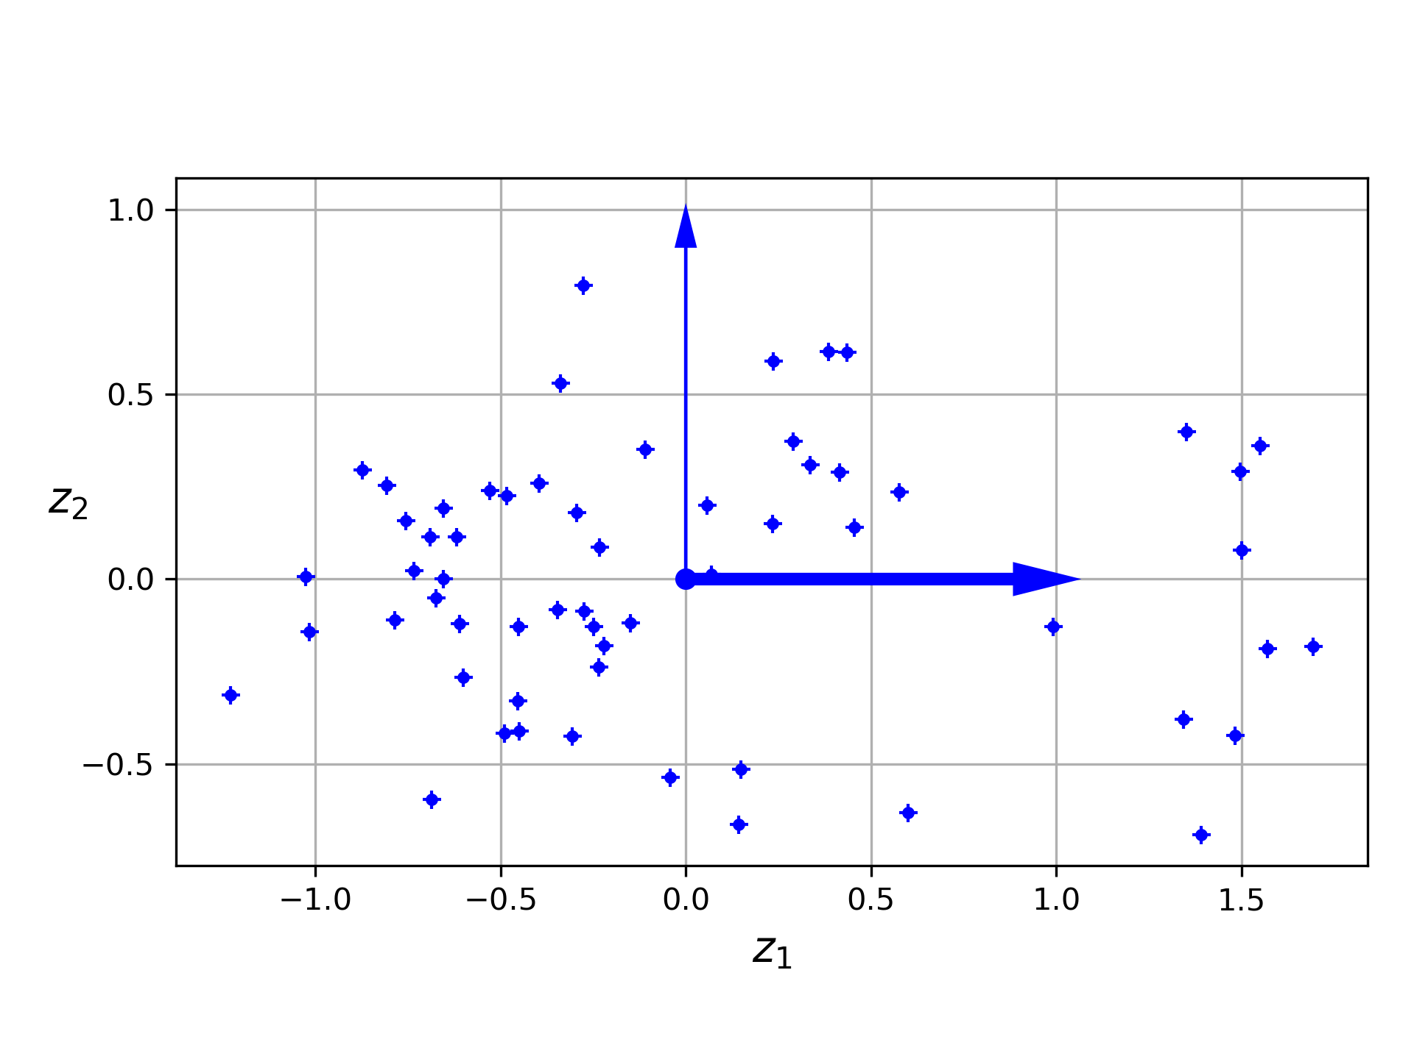
Projection
In most real-world problems, training instances are not spread out uniformly across all dimensions.
Many features are almost constant.
Others are highly correlated.
All training instances lie within (or close to) a much lower-dimensional subspace of the high-dimensional space.
Notes:
Highly correlated: (as discussed earlier for MNIST). Pixels close to each other are correlated
In the picture, if we project every training instance perpendicularly onto this subspace, we get a new 2D dataset.
We have just reduced the dataset’s dimensionality from 3D to 2D. Note that the axes correspond to new features z1 and z2: they are the coordinates of the projections on the plane.

Slide 7
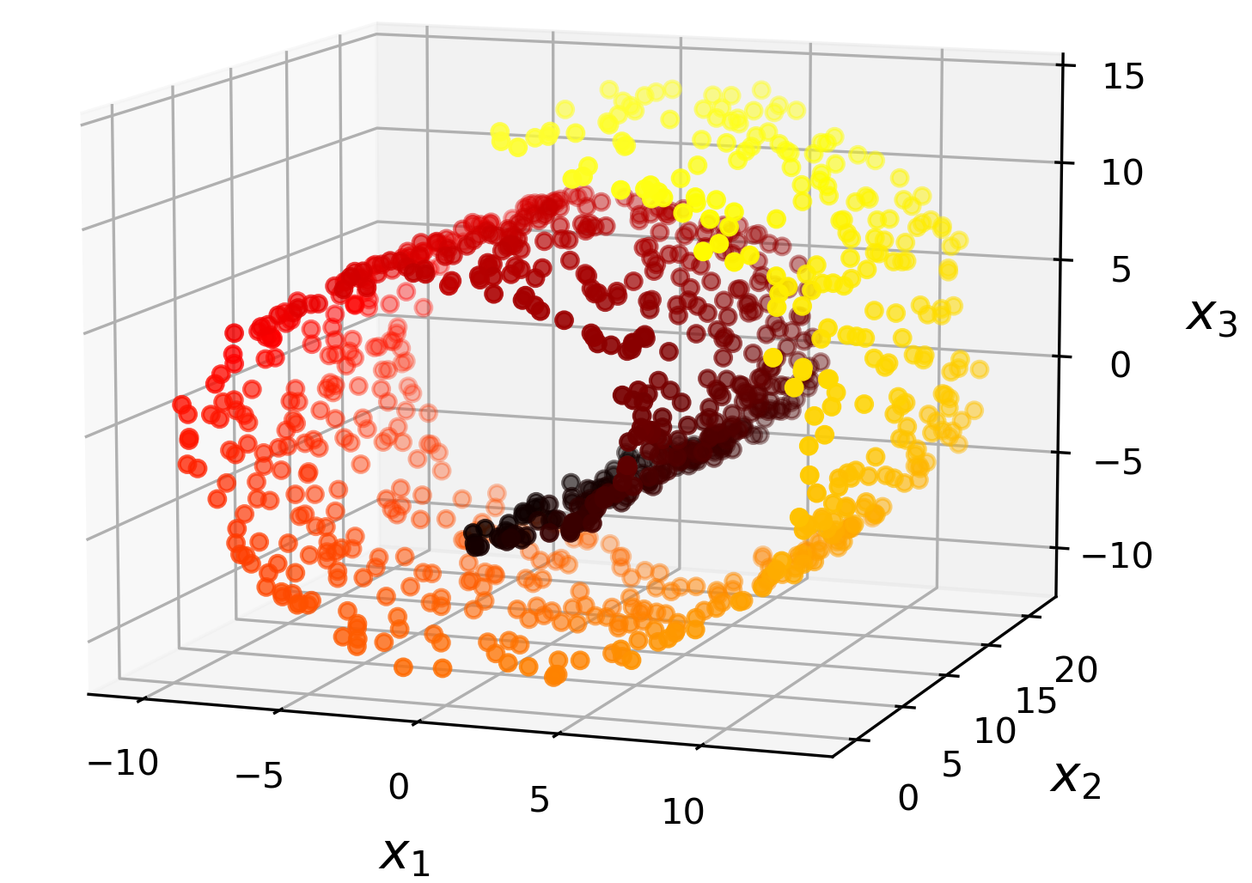
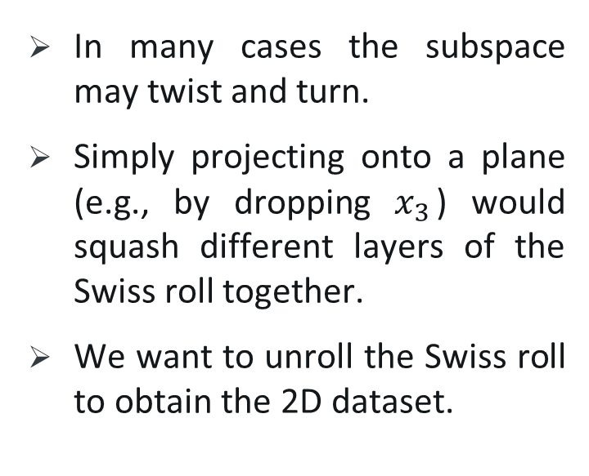
Manifold Learning
In many cases the subspace may twist and turn.
Simply projecting onto a plane (e.g., by dropping $x_{3}$) would squash different layers of the Swiss roll together.
We want to unroll the Swiss roll to obtain the 2D dataset.
Notes:
Nonlinear dimensionality reduction, also known as manifold learning, refers to various related techniques that aim to project high-dimensional data onto lower-dimensional latent manifolds
It's a space that locally resembles Euclidean space, but globally it might have a more complex structure.
a manifold is a topological space that is locally homeomorphic to Euclidean space. This means that around each point on the manifold, there exists a neighborhood that is topologically equivalent (or homeomorphic) to an open set in Euclidean space.
a function f between two topological spaces X and Y is a homeomorphism if:
f is a bijection (both injective and surjective).
f is continuous.
The inverse function f^(−1) is also continuous.
Flatness: Euclidean space is flat, meaning it obeys the rules of Euclidean geometry, where parallel lines remain equidistant and never meet, and the interior angles of triangles add up to 180 degrees.
Metric Properties: It has a metric structure that defines distances between points
Coordinate System: Euclidean spaces are often represented using Cartesian coordinate systems, where each point in space corresponds to a unique set of coordinates. These coordinates help define the position of points and the distances between them.

Slide 8
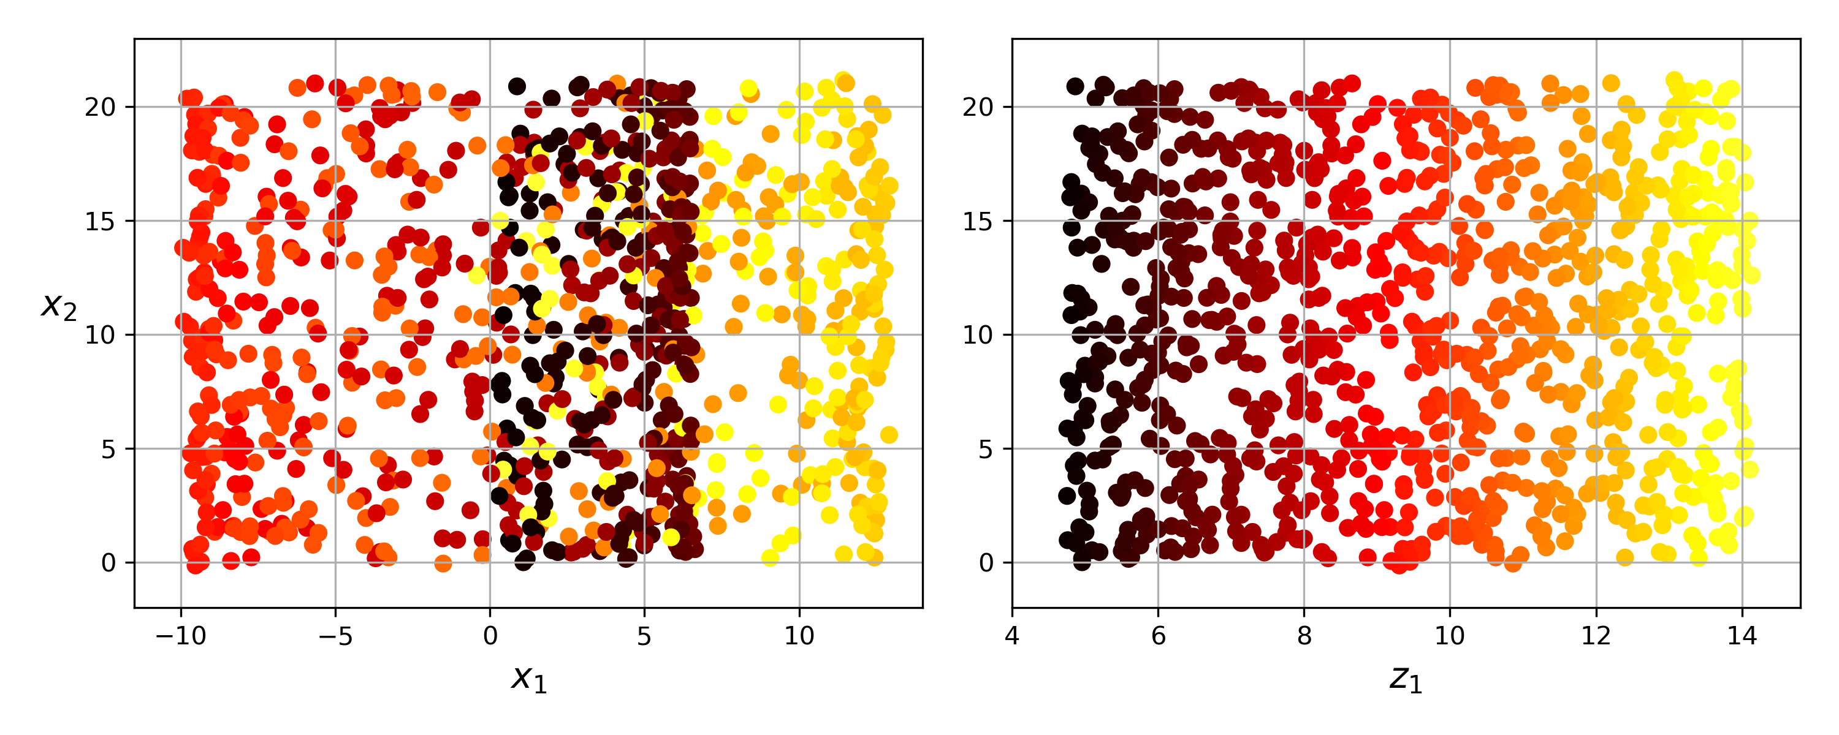
Manifold Learning
projecting onto a plane
unrolling the Swiss roll

Slide 9
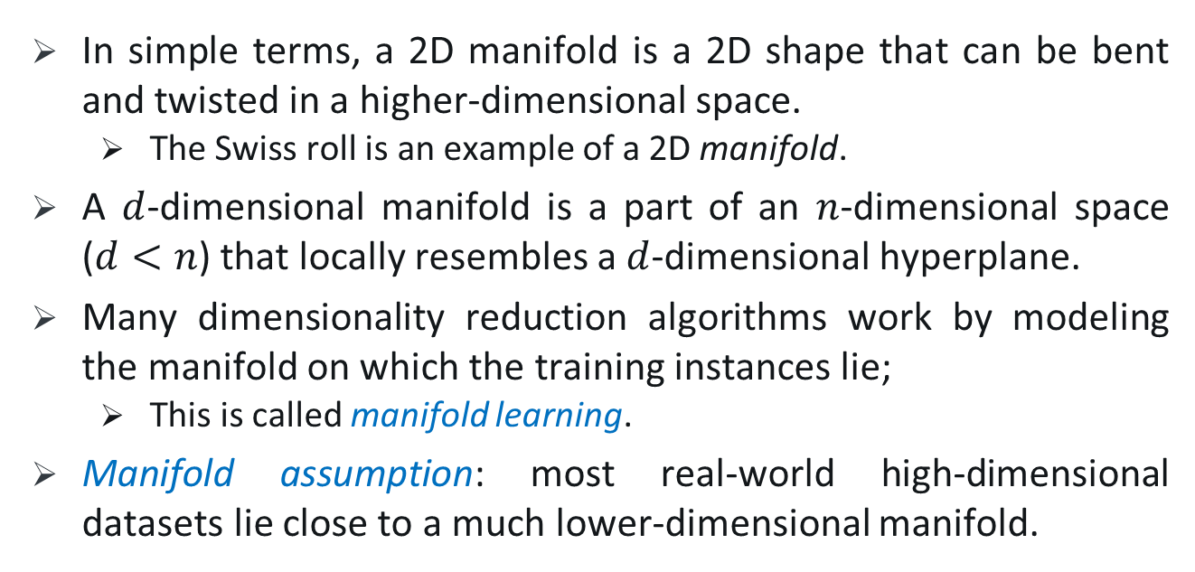
Manifold Learning
In simple terms, a 2D manifold is a 2D shape that can be bent and twisted in a higher-dimensional space.
The Swiss roll is an example of a 2D manifold.
A $d$-dimensional manifold is a part of an $n$-dimensional space ($d<n$) that locally resembles a $d$-dimensional hyperplane.
Many dimensionality reduction algorithms work by modeling the manifold on which the training instances lie;
This is called manifold learning.
Manifold assumption: most real-world high-dimensional datasets lie close to a much lower-dimensional manifold.
Notes:
manifold learning relies on the manifold assumption, also called the manifold hypothesis, which holds that most real-world …
پیوستگی و smoothness حفظ میشه

Slide 10
Example
Consider the MNIST dataset: all handwritten digit images have some similarities.
They are made of connected lines, the borders are white, and they are more or less centered.
If you randomly generated images, only a tiny fraction of them would look like handwritten digits.
The degrees of freedom available to you if you try to create a digit image are dramatically lower than the degrees of freedom you have if you are allowed to generate any image you want.
These constraints tend to squeeze the dataset into a lower-dimensional manifold.

Slide 11
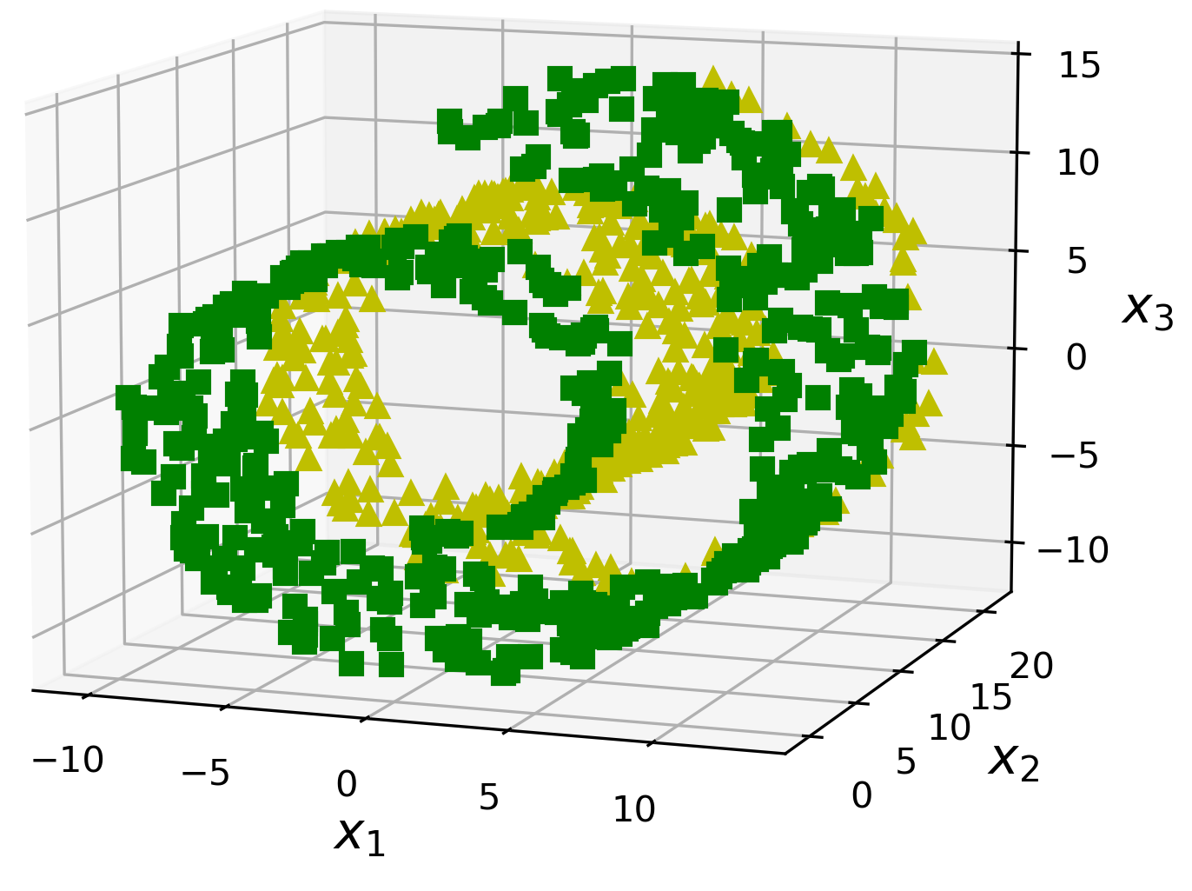
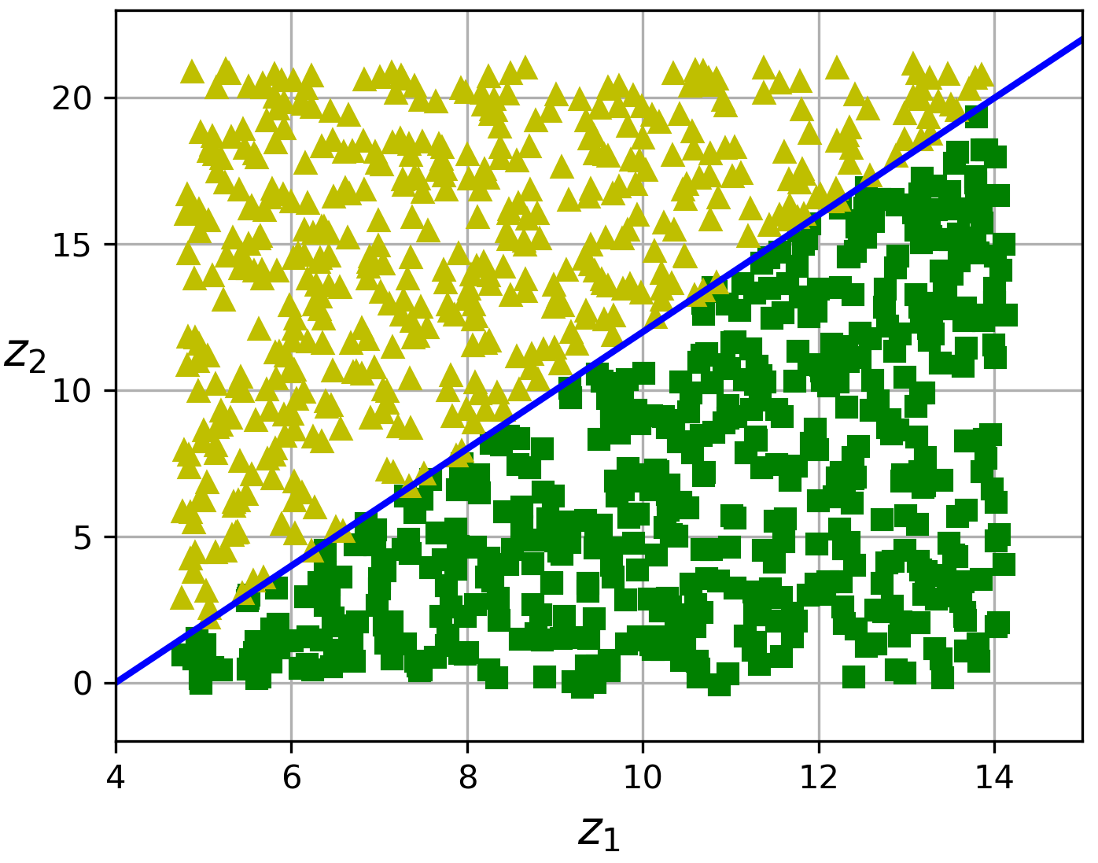
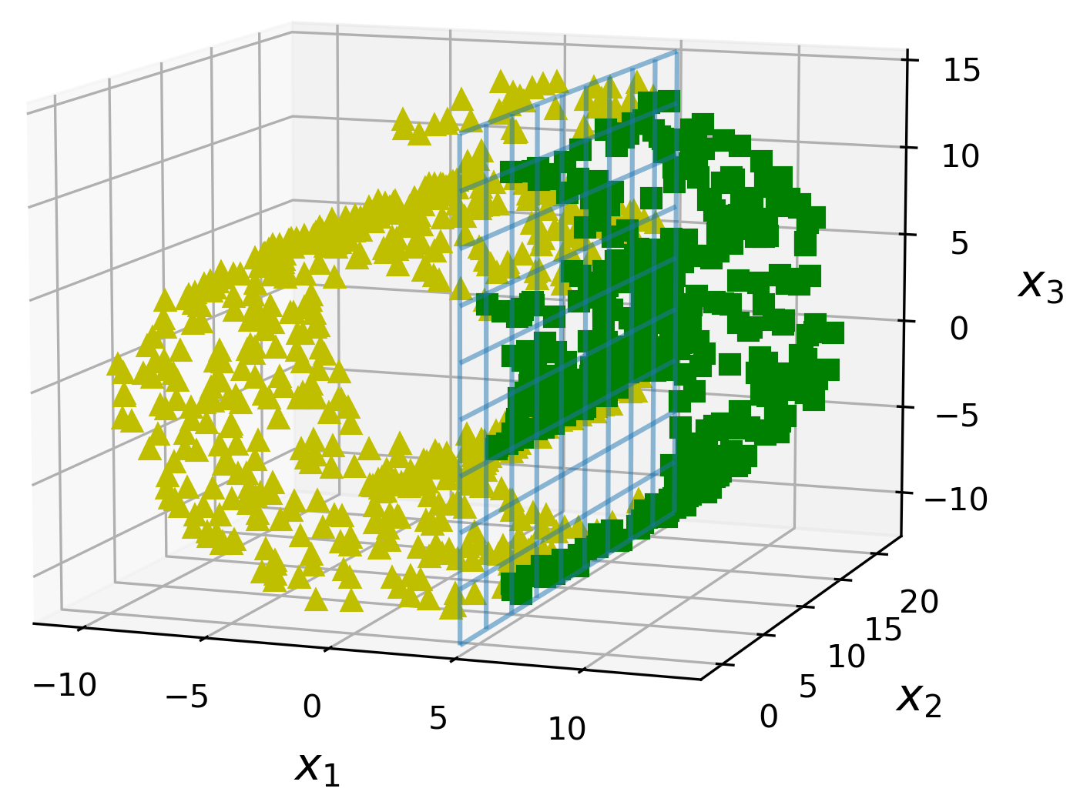
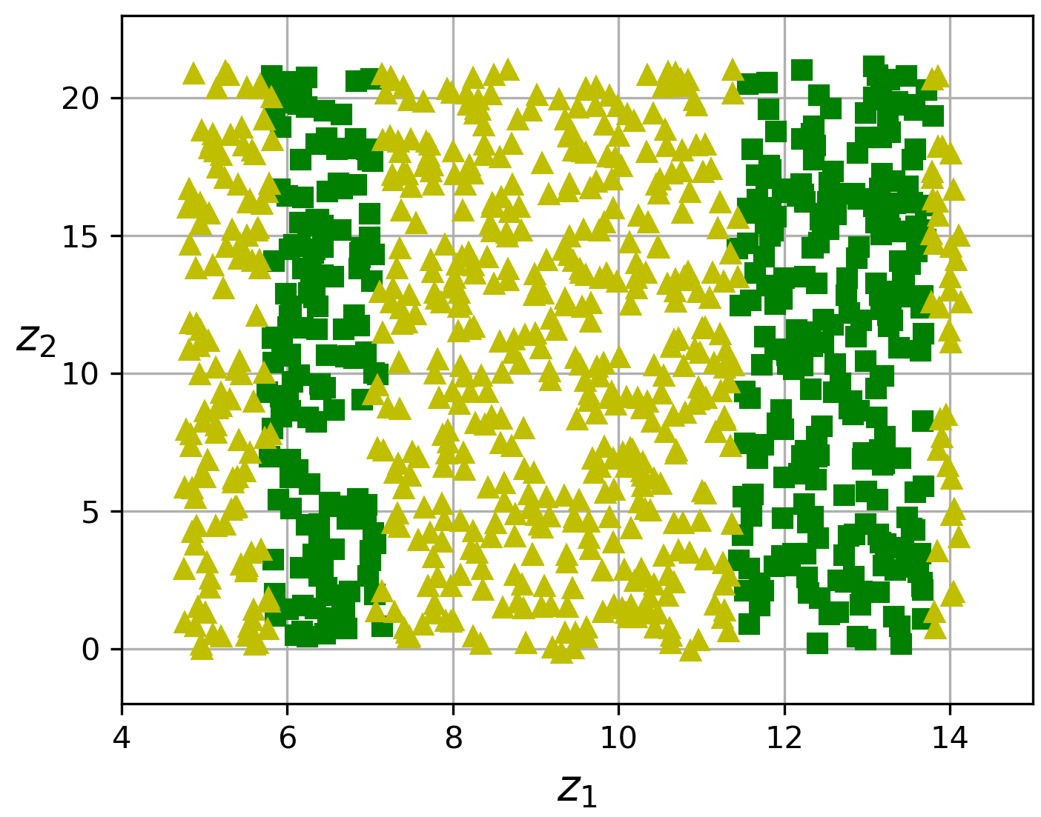
Notes:
The manifold assumption is often accompanied by another implicit assumption: that the task at hand (e.g., classification or regression) will be simpler if expressed in the lower-dimensional space of the manifold. For example, in the top row of Figure 8-6 the Swiss roll is split into two classes: in the 3D space (on the left) the decision boundary would be fairly complex, but in the 2D unrolled manifold space (on the right) the decision boundary is a straight line.
However, this implicit assumption does not always hold. For example, in the bottom row of Figure 8-6, the decision boundary is located at x1 = 5. This decision boundary looks very simple in the original 3D space (a vertical plane), but it looks more complex in the unrolled manifold (a collection of four independent line segments). In short, reducing the dimensionality of your training set before training a model will usually speed up training, but it may not always lead to a better or simpler solution; it all depends on the dataset.

Slide 12
2.
Principal Component Analysis

Slide 13
Principal Component Analysis
Principal component analysis (PCA) is the most popular dimensionality reduction algorithm.
First it identifies the hyperplane that lies closest to the data, and then it projects the data onto it.
How to choose the right hyperplane?
Select the axis that preserves the
maximum amount of variance
Notes:
manifold learning relies on the manifold assumption, also called the manifold hypothesis, which holds that most real-world …

Slide 14
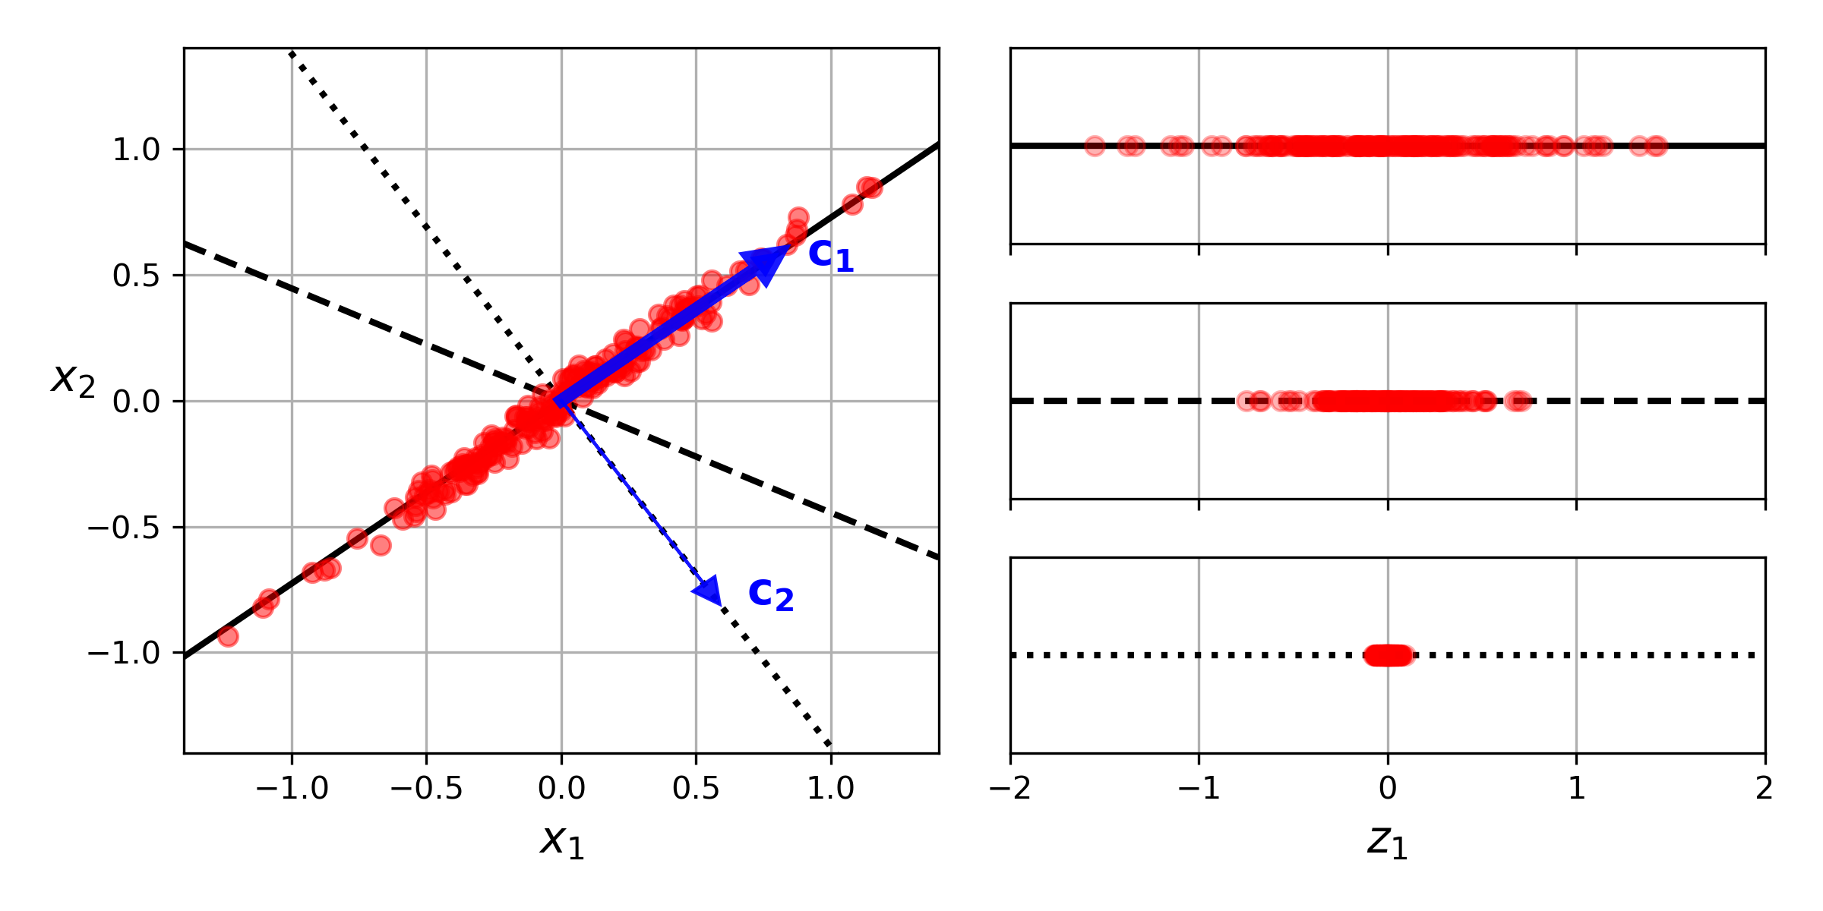
Preserving the Variance
Select the axis that preserves the maximum amount of variance, as it will lose less information than the other projections
Notes:
On the right is the result of the projection of the dataset onto each of these axes. As you can see, the projection onto the solid line preserves the maximum variance (top), while the projection onto the dotted line preserves very little variance (bottom) and the projection onto the dashed line preserves an intermediate amount of variance (middle).

Slide 15


Principal Components
PCA identifies the axis that accounts for the largest amount of variance in the training set ($c_{1}$), then a second axis, orthogonal to the first one ($c_{2}$), that accounts for the largest amount of the remaining variance.
The $i$-th axis is called the $i$-th principal component (PC) of the data.
Notes:
If it were a higher-dimensional dataset, PCA would also find a third axis, orthogonal to both previous axes, and a fourth, a fifth, and so on—as many axes as the number of dimensions in the dataset

Slide 16
Principal Components
Notes:
In Figure 8-2 the first two PCs are on the projection plane, and the third PC is the axis orthogonal to that plane. After the projection, in Figure 8-3, the first PC corresponds to the z1 axis, and the second PC corresponds to the z2 axis.

Slide 17

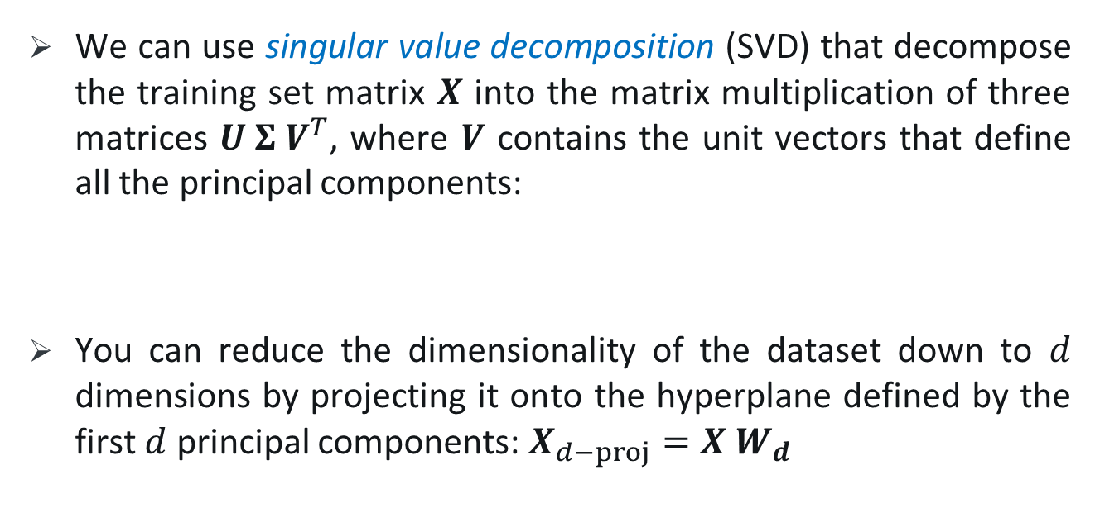
Finding Principal Components
We can use singular value decomposition (SVD) that decompose the training set matrix $X$ into the matrix multiplication of three matrices $U Σ V^{T}$, where $V$ contains the unit vectors that define all the principal components:
You can reduce the dimensionality of the dataset down to $d$ dimensions by projecting it onto the hyperplane defined by the first $d$ principal components: $X_{d−proj}=X{ W}_{d}$
Notes:
PCA assumes that the dataset is centered around the origin. As you will see, Scikit-Learn’s PCA classes take care of centering the data for you.
Wd, defined as the matrix containing the first d columns of V U , V are unitary: unitary if its conjugate transpose U* is also its inverse, that is, if UU* = U*U = I
U: mxm , V: nxn , sigma : mxn

Slide 18
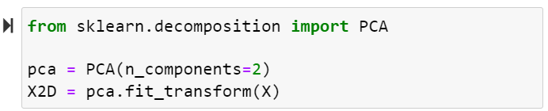
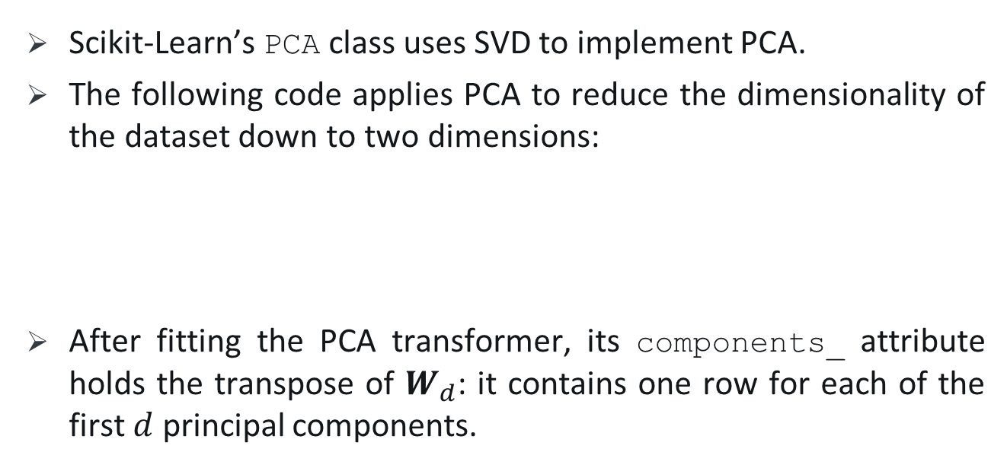
PCA in Scikit-Learn
Scikit-Learn’s PCA class uses SVD to implement PCA.
The following code applies PCA to reduce the dimensionality of the dataset down to two dimensions:
After fitting the PCA transformer, its components_ attribute holds the transpose of $W_{d}$: it contains one row for each of the first $d$ principal components.

Slide 19
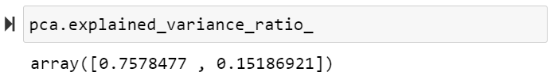
Explained Variance Ratio
The explained variance ratio of each principal component, available via the explained_variance_ratio_ variable, indicates the proportion of the dataset’s variance that lies along each principal component.
Notes:
This output tells us that about 76% of the dataset’s variance lies along the first PC, and about 15% lies along the second PC. This leaves about 9% for the third PC, so it is reasonable to assume that the third PC probably carries little information.

Slide 20
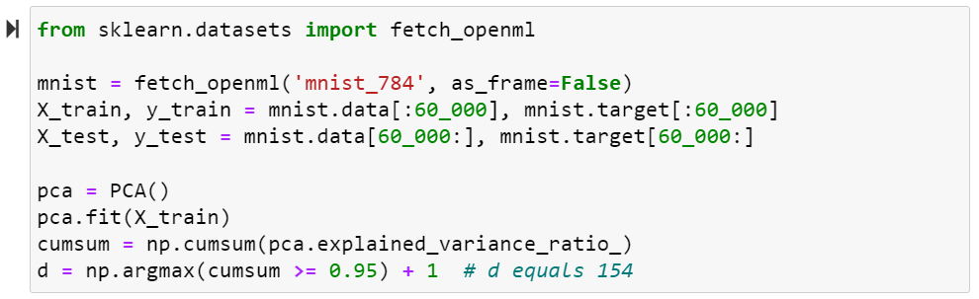
Choosing the Right Number of Dimensions
Choose the number of dimensions that add up to a sufficiently large portion of the variance—say, 95%.
You could then set n_components=d and run PCA again.
Notes:
(An exception to this rule, of course, is if you are reducing dimensionality for data visualization, in which case you will want to reduce the dimensionality down to 2 or 3). The following code loads and splits the MNIST dataset and performs PCA without reducing dimensionality, then computes the minimum number of dimensions required to preserve 95% of the training set’s variance
Return the cumulative sum of the elements along a given axis:
np.array([[1,2,3], [4,5,6]])
>>> a array([[1, 2, 3], [4, 5, 6]])
>>> np.cumsum(a) array([ 1, 3, 6, 10, 15, 21])

Slide 21
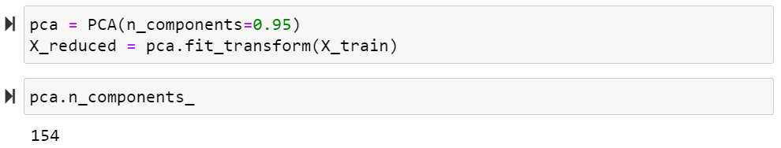
Choosing the Right Number of Dimensions
Instead of specifying the number of principal components you want to preserve, you can set n_components to be a float between 0.0 and 1.0, indicating the ratio of variance you wish to preserve:

Slide 22
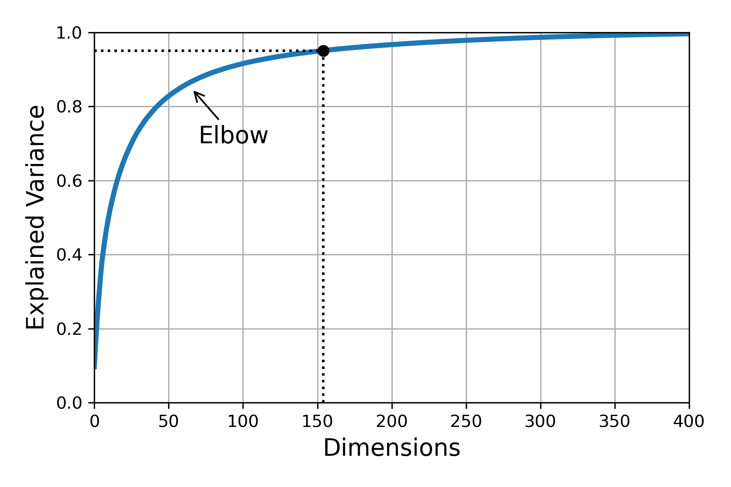
Choosing the Right Number of Dimensions
Plot the explained variance as a function of the number of dimensions, there will usually be an elbow in the curve, where the explained variance stops growing fast:
Notes:
In this case, you can see that reducing the dimensionality down to about 100 dimensions wouldn’t lose too much explained variance.

Slide 23
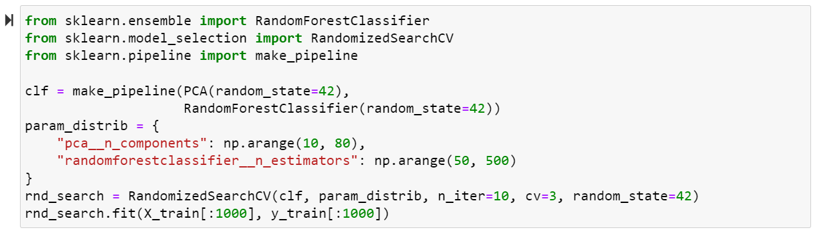
Choosing the Right Number of Dimensions
If you are using dimensionality reduction as a preprocessing step for a supervised learning task, then you can tune the number of dimensions as you would any other hyperparameter.
Notes:
For example, the following code example creates a two-step pipeline, first reducing dimensionality using PCA, then classifying using a random forest. Next, it uses RandomizedSearchCV to find a good combination of hyperparameters for both PCA and the random forest classifier. This example does a quick search, tuning only 2 hyperparameters, training on just 1,000 instances, and running for just 10 iterations,
the optimal number of components is: we reduced a 784-dimensional dataset to just 23 dimensions! This is tied to the fact that we used a random forest, which is a pretty powerful model. If we used a linear model instead such as an SGDClassifier, the search would find that we need to preserve more dimensions (about 70).

Slide 24
PCA for Compression
After dimensionality reduction, the training set takes up less space.
E.g. MNIST dataset after PCA is less than 20% of its original size, and we only lost 5% of its variance!
It is possible to decompress the reduced dataset by applying the inverse transformation of the PCA projection.
The mean squared distance between the original data and the reconstructed data (compressed and then decompressed) is called the reconstruction error.
Use the inverse_transform() method to decompress:
Notes:
For example, after applying PCA to the MNIST dataset while preserving 95% of its variance, we are left with 154 features, instead of the original 784 features.
This won’t give you back the original data, since the projection lost a bit of information (within the 5% variance that was dropped), but it will likely be close to the original data.

Slide 25
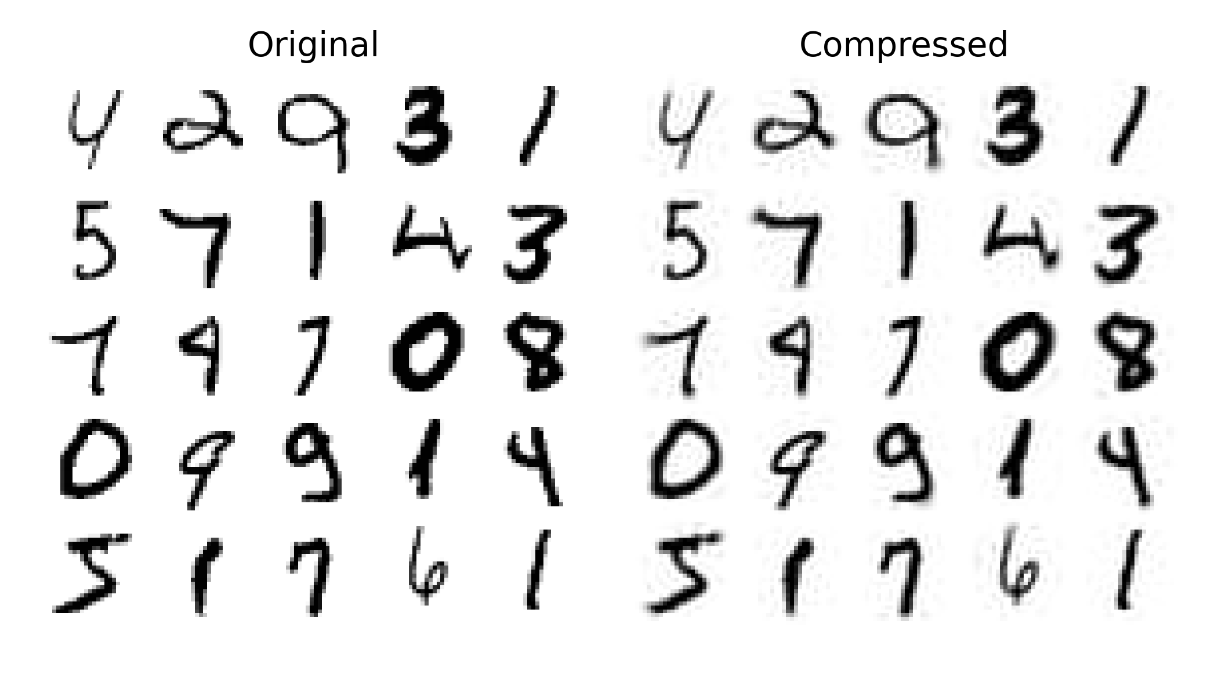
PCA for Compression
Notes:
shows a few digits from the original training set (on the left), and the corresponding digits after compression and decompression. You can see that there is a slight image quality loss, but the digits are still mostly intact.

Slide 26
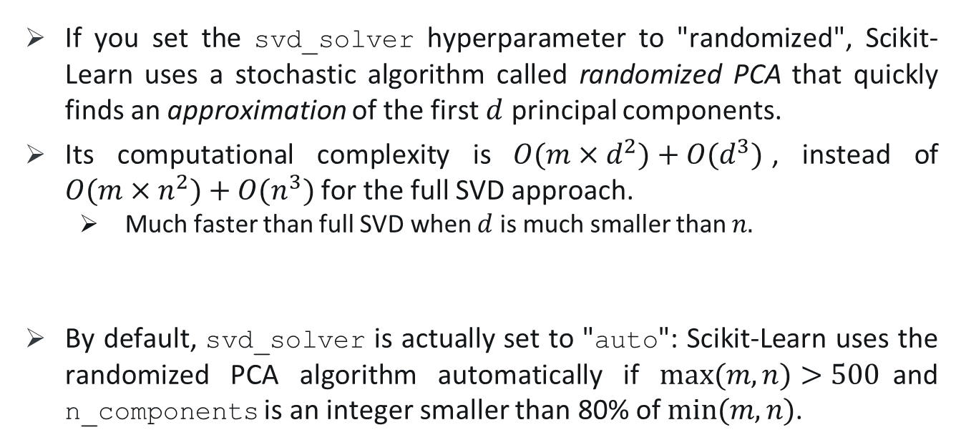
Randomized PCA
If you set the svd_solver hyperparameter to "randomized", Scikit-Learn uses a stochastic algorithm called randomized PCA that quickly finds an approximation of the first $d$ principal components.
Its computational complexity is $O(m×d^{2})+O(d^{3})$, instead of $O(m×n^{2})+O(n^{3})$ for the full SVD approach.
Much faster than full SVD when $d$ is much smaller than $n.$
By default, svd_solver is actually set to "auto": Scikit-Learn uses the randomized PCA algorithm automatically if $max⁡(m, n)>500$and n_components is an integer smaller than 80% of $min⁡(m,n)$.
Notes:
So the preceding code would use the randomized PCA algorithm even if you removed the svd_solver="randomized" argument, since 154 < 0.8 × 784. If you want to force Scikit-Learn to use full SVD for a slightly more precise result, you can set the svd_solver hyperparameter to "full".

Slide 27
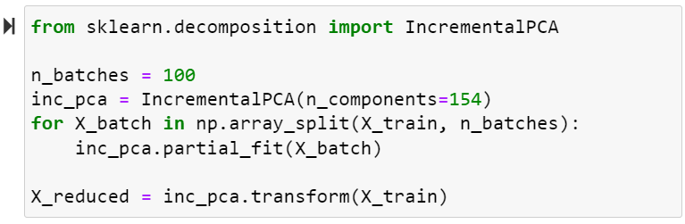
Incremental PCA
PCA requires the whole training set to fit in memory.
Incremental PCA (IPCA) algorithms have been developed that allow you to split the training set into mini-batches and feed these in one mini-batch at a time.
This is useful for large training sets and for applying PCA online.
Notes:
The following code splits the MNIST training set into 100 mini-batches (using NumPy’s array_split() function) and feeds them to Scikit-Learn’s IncrementalPCA class5 to reduce the dimensionality of the MNIST dataset down to 154 dimensions, just like.
Note that you must call the partial_fit() method with each mini-batch, rather than the fit() method with the whole training set:
Alternatively (instead of loop), you can use NumPy’s memmap class, which allows you to manipulate a large array stored in a binary file on disk as if it were entirely in memory; the class loads only the data it needs in memory, when it needs it

Slide 28
3.
Random Projection

Slide 29
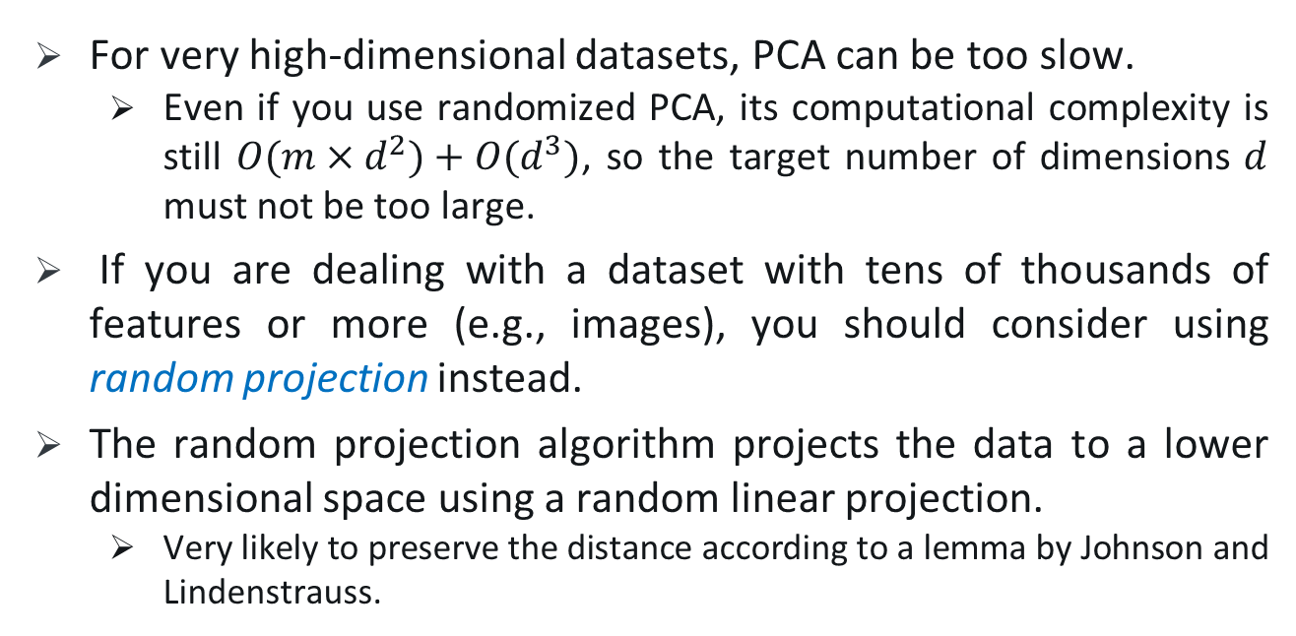
Random Projection
For very high-dimensional datasets, PCA can be too slow.
Even if you use randomized PCA, its computational complexity is still $O(m×d^{2})+O(d^{3})$, so the target number of dimensions $d$ must not be too large.
If you are dealing with a dataset with tens of thousands of features or more (e.g., images), you should consider using random projection instead.
The random projection algorithm projects the data to a lower dimensional space using a random linear projection.
Very likely to preserve the distance according to a lemma by Johnson and Lindenstrauss.
Notes:
then training may become much too slow: in this case
This may sound crazy, but it turns out that such a random projection is actually very likely to preserve distances fairly well, as was demonstrated mathematically by William B. Johnson and Joram Lindenstrauss in a famous lemma. So, two similar instances will remain similar after the projection, and two very different instances will remain very different.

Slide 30
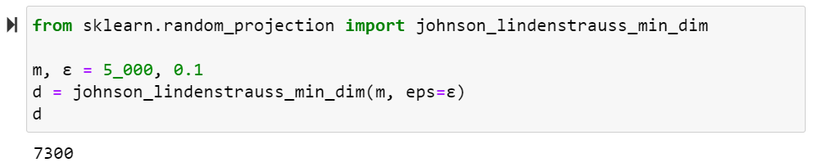

Random Projection
Johnson and Lindenstrauss showed the minimum number of dimensions to preserve in order to ensure—with high probability—that distances won’t change by more than a given tolerance $ε$ is:
$$d ≥ 4 log⁡(m) / (½ ε² − ⅓ ε³)$$
Notes:
dataset containing m = 5,000 instances with n = 20,000 features

Slide 31
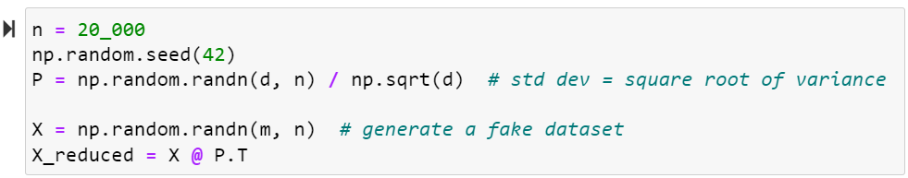
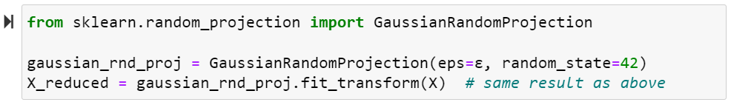

Random Projection
Generate a random matrix $P$ of shape $[d, n],$ where each item is sampled randomly from a Gaussian distribution with mean 0 and variance $1/d$, and use it to project a dataset from $n$ dimensions down to $d$:
Scikit-Learn offers a GaussianRandomProjection class to do this:
Notes:
dataset containing m = 5,000 instances with n = 20,000 features when you call its fit() method, it uses johnson_lindenstrauss_min_dim() to

Slide 32
Sparse Random Projection
Scikit-Learn also provides SparseRandomProjection.
The main difference is that the random matrix is sparse.
This means it uses much less memory: about 25 MB instead of almost 1.2 GB in the previous example!
And much faster, both to generate the random matrix and to reduce dimensionality: about 50% faster in this case.
If the input is sparse, the transformation keeps it sparse.
It enjoys the same distance-preserving property, and the quality of the dimensionality reduction is comparable.
In short, it’s usually preferable to use this transformer instead of the first one, especially for large or sparse datasets.
Notes:
dataset containing m = 5,000 instances with n = 20,000 features
, a 2017 paper7 by Sanjoy Dasgupta et al. showed that the brain of a fruit fly implements an analog of random projection to map dense low-dimensional olfactory inputs to sparse high-dimensional binary outputs: مگس میوه

Slide 33
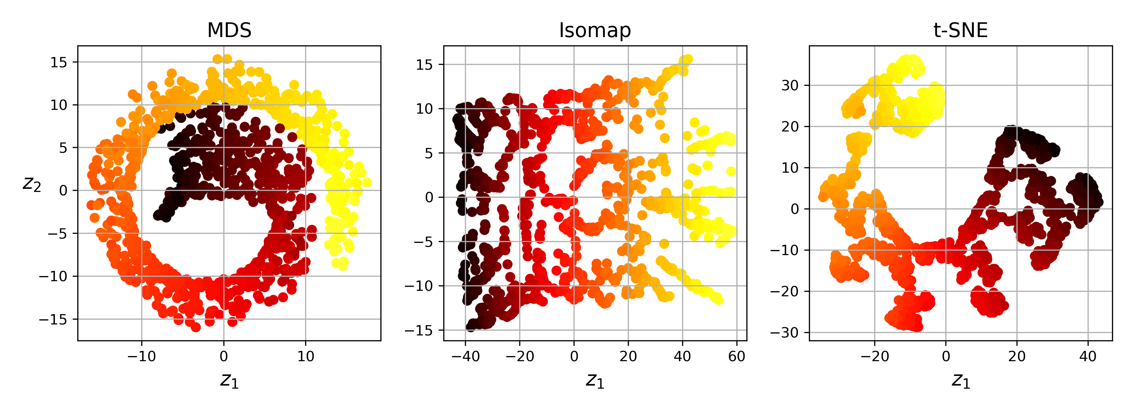
Other Dimensionality Reduction Techniques
Notes:
Figure 8-11 shows the results of MDS, Isomap, and t-SNE on the Swiss roll.
MDS manages to flatten the Swiss roll without losing its global curvature, while Isomap drops it entirely.
Depending on the downstream task, preserving the large-scale structure may be good or bad.
t-SNE does a reasonable job of flattening the Swiss roll, preserving a bit of curvature, and it also amplifies clusters, tearing the roll apart. Again, this might be good or bad, depending on the downstream task.

Slide 34
Unsupervised Learning (K-Means)

Slide 35
Unsupervised Learning
Most of the applications of machine learning today are based on supervised learning, but the vast majority of the available data is unlabeled.
Common unsupervised learning task:
Clustering: group similar instances together into clusters.
Anomaly detection (outlier detection): learn what “normal” data
looks like, and then use that to detect abnormal instances.
Density estimation: estimating the probability density function
(PDF) of the random process that generated the dataset.

Slide 36
Question
Difference between anomaly and outlier data?

Slide 37
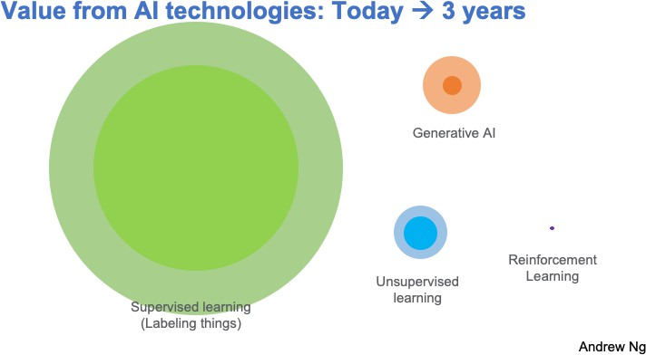

Slide 38
Clustering
1.
5

Slide 39
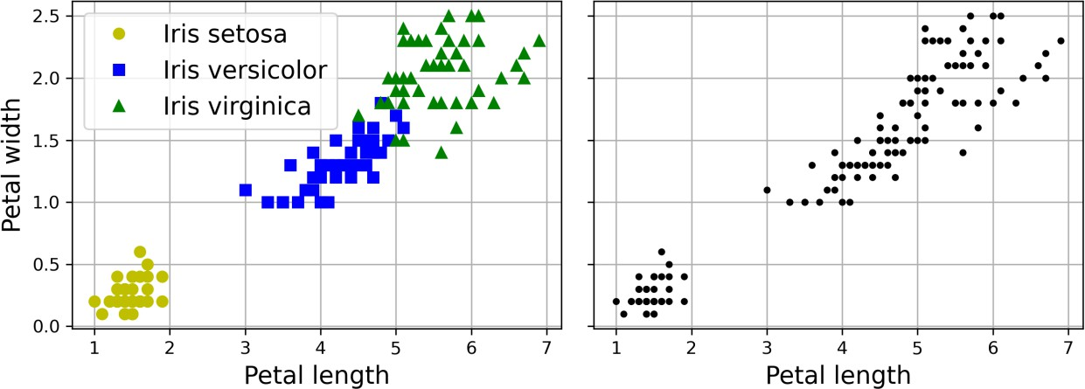
Clustering
Clustering: the task of identifying similar instances and assigning them to
clusters, or groups of similar instances.
Similar to classification, each instance gets assigned to a group. But, unlike classification, clustering is an unsupervised task.

Slide 40
Applications of Clustering
Customer segmentation: cluster customers based on their activity to adapt your products and marketing campaigns to each segment.
Data analysis: when you analyze a new dataset, it can be helpful to run
a clustering algorithm, and then analyze each cluster separately.
Dimensionality reduction: each instance’s feature vector 𝐱 can be replaced with the vector of its cluster affinities.
affinity is any measure of how well an instance fits into a cluster.
Feature engineering: the cluster affinities can often be useful as extra features.
Anomaly detection: any instance that has a low affinity to all the
clusters is likely to be an anomaly.

Slide 41
Applications of Clustering
Semi-supervised learning: if you only have a few labels, you could perform clustering and propagate the labels to all the instances in the same cluster.
Search engines: to search for images that are similar to a reference image, apply a clustering algorithm to all the images in your database; and return all the images from the cluster of the searched image.
Image segmentation: cluster pixels according to their color, then replace each pixel’s color with the mean color of its cluster.
Image segmentation is used in many object detection and tracking
systems, as it makes it easier to detect the contour of each object.

Slide 42
𝐾-means
2.
9

Slide 43
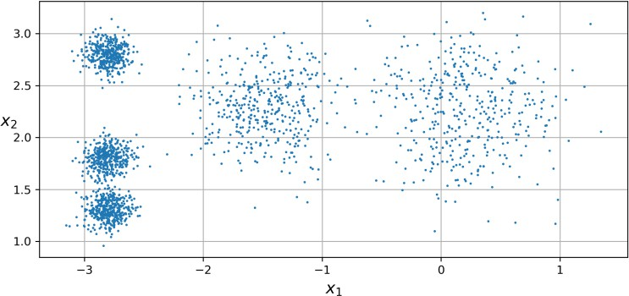
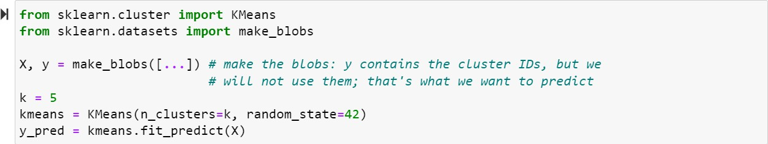
K-means
𝑘-means is a simple algorithm capable of clustering many datasets quickly and efficiently.
We have to specify the number of clusters 𝑘 that the algorithm must find.

Slide 44
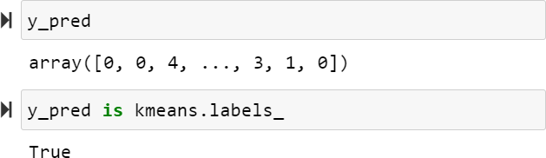
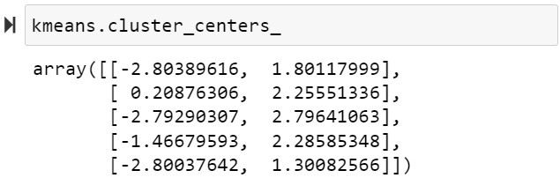
K-means
Each instance will be assigned to one of the five clusters.
An instance’s label is the index of its cluster.
KMeans instance preserves the predicted labels of the instances
it was trained on, available via the labels_ instance variable:
The centroids that the algorithm found:

Slide 45
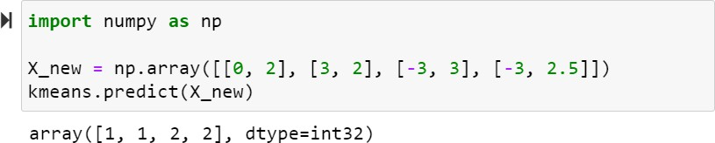
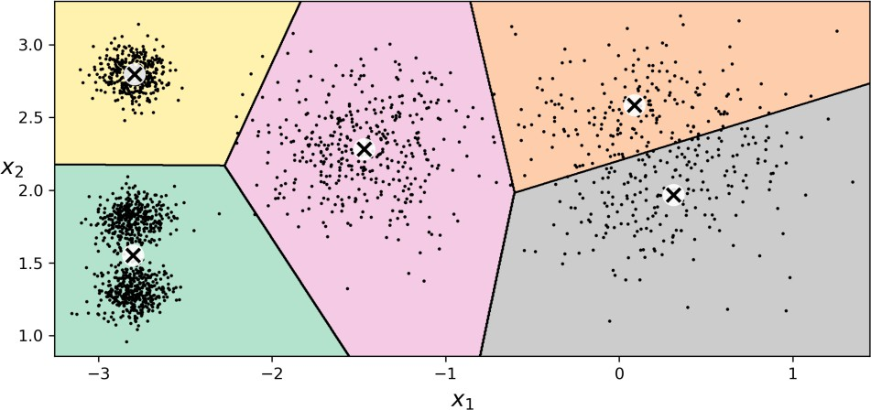
K-means
New instances get assigned to the cluster whose centroid is
closest:

Slide 46
The k-means algorithm
If you have the centroids, you could label the instances in the dataset
by assigning them to the cluster whose centroid is closest.
If you have all the instance labels, you could locate each cluster’s centroid by computing the mean of the instances in that cluster.
Start by placing the centroids randomly:
label the instances
update the centroids
repeat (1) and (2) until the centroids stop moving.
The algorithm is guaranteed to converge in a finite number of steps because the mean squared distance between the instances and their closest centroids can only go down at each step.

Slide 47
Visualization
Visualizing K-Means Clustering

Slide 48
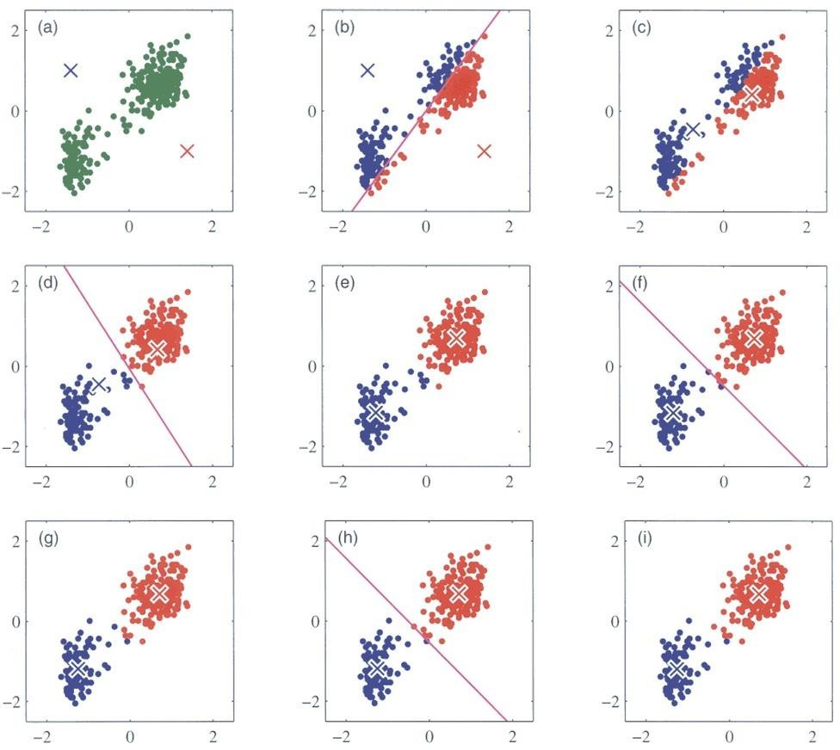

Slide 49
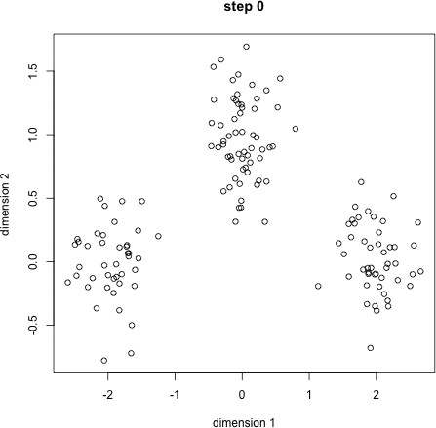

Slide 50
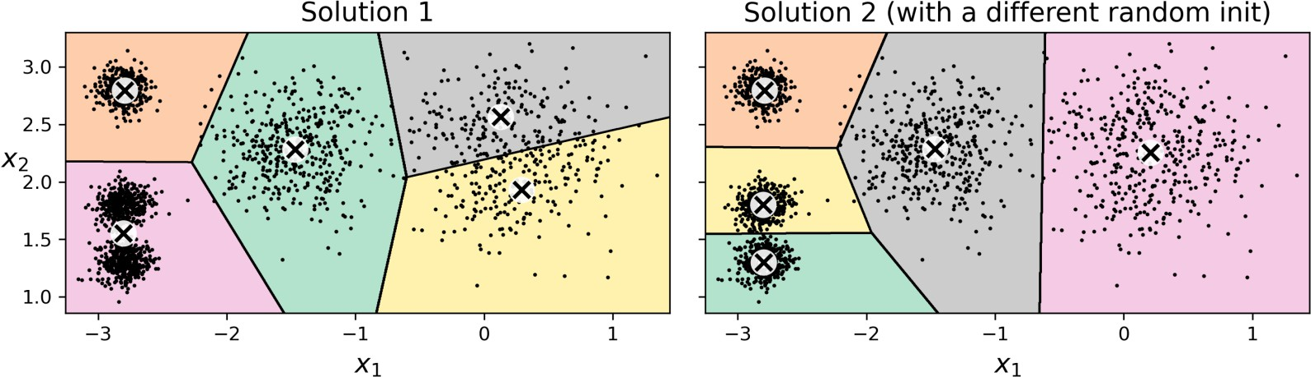
K-means disadvantage
Although the algorithm is guaranteed to converge, it may not converge to the right solution
it may converge to a local optimum
whether it does or not depends on the centroid initialization.

Slide 51
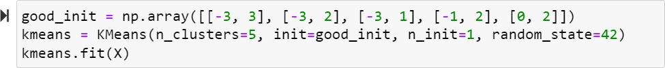
Centroid initialization methods
If you know approximately where the centroids should be (e.g., if you ran another clustering algorithm earlier), then you can set the init hyperparameter to a NumPy array containing the list of centroids:
Another solution is to run the algorithm multiple times with different random initializations and keep the best solution.
The number of random initializations is controlled by the n_init.
The default it is equal to 10.

Slide 52


Performance Metric
Model’s inertia: the sum of the squared distances between the instances and their closest centroids.
The KMeans class runs the algorithm n_init times and keeps the
model with the lowest inertia.
A model’s inertia is accessible via the inertia_ instance variable:
The score() method returns the negative inertia.
It is negative because a predictor’s score() method must always respect
Scikit-Learn’s “greater is better” rule.

Slide 53

K-means++
A smarter initialization step that tends to select centroids that are distant from one another.
It makes the 𝑘-means algorithm much less likely to converge to
a suboptimal solution.
Take one centroid 𝒄⁽¹⁾, chosen uniformly at random from the dataset.
Take a new centroid 𝒄^{(𝑖)}, choosing an instance 𝐱^{(𝑖)} with probability
2
𝐷 𝐱 ^{𝑖}
₂ where 𝐷(𝐱 ^{𝑗} ) is the distance between the instance 𝐱^{(𝑗)}
_{σ}𝑚
𝐷 𝐱 ^{𝑗}
𝑗=1
and the closest centroid that was already chosen.
3. Repeat the previous step until all 𝑘 centroids have been chosen.

Slide 54
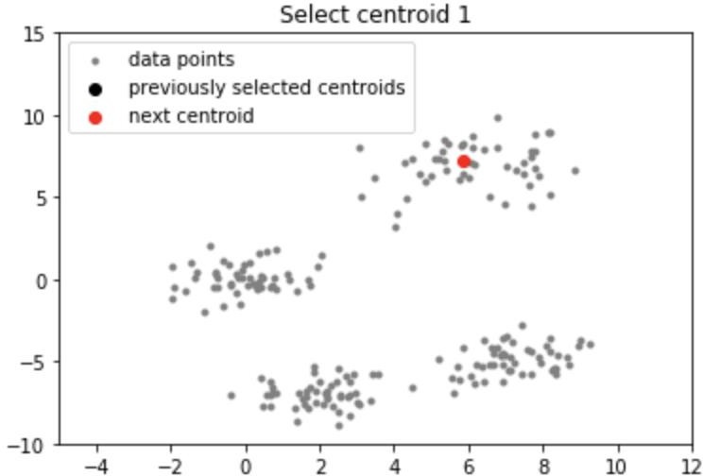
K-means++

Slide 55
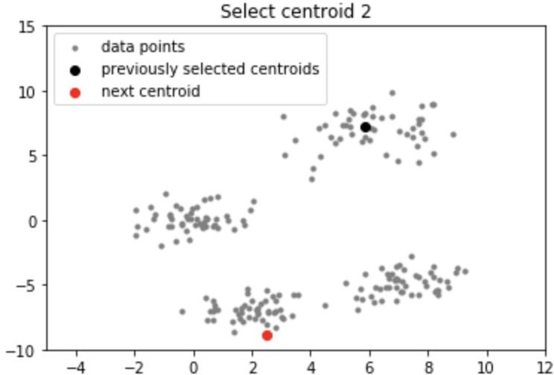
K-means++

Slide 56
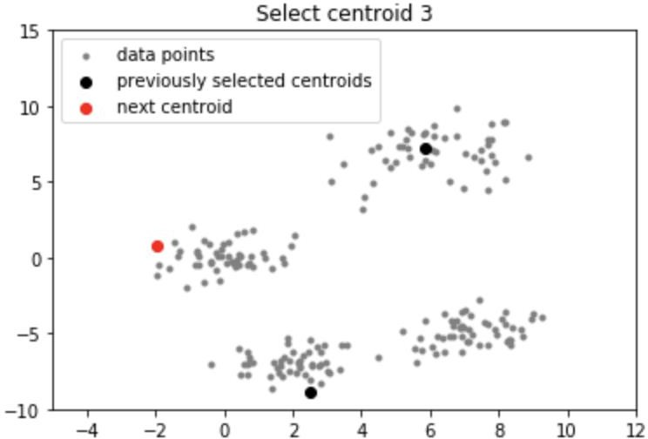
K-means++

Slide 57
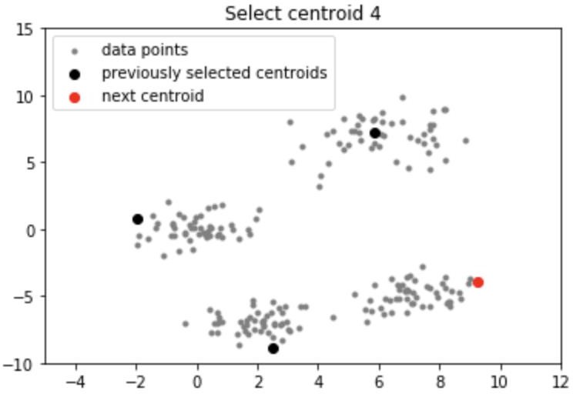
K-means++

Slide 58
Accelerated 𝑘-means
Another improvement to the k-means algorithm was proposed in a 2003 paper by Charles Elkan.
On some large datasets with many clusters, the algorithm can be
accelerated by avoiding many unnecessary distance calculations.
Elkan achieved this by exploiting the triangle inequality and by keeping track of lower and upper bounds for distances between instances and centroids.
Elkan’s algorithm does not always accelerate training, and sometimes it can even slow down training significantly;
It depends on the dataset.
You can try it by setting algorithm="elkan".

Slide 59
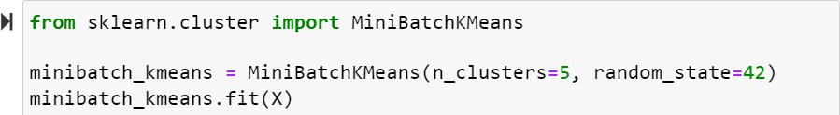
Mini-batch 𝑘-means
Mini-batch k-means: instead of using the full dataset at each iteration, the algorithm is capable of using mini-batches, moving the centroids just slightly at each iteration.
This speeds up the algorithm (typically by a factor of three to four) and makes it possible to cluster huge datasets that do not fit in memory.
Scikit-Learn implements this algorithm in the
class, which you can use just like the KMeans class:
MiniBatchKMeans

Slide 60
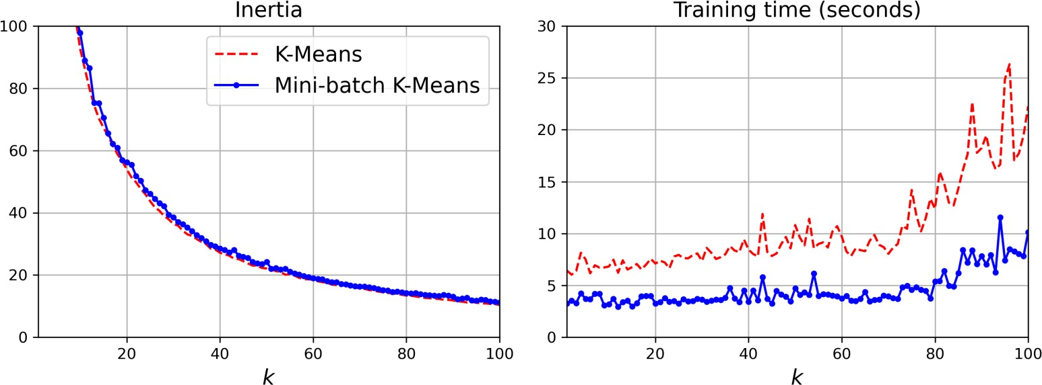
Mini-batch k-means
Although the mini-batch 𝑘-means algorithm is much faster than the regular 𝑘-means algorithm, its inertia is generally slightly worse.

Slide 61
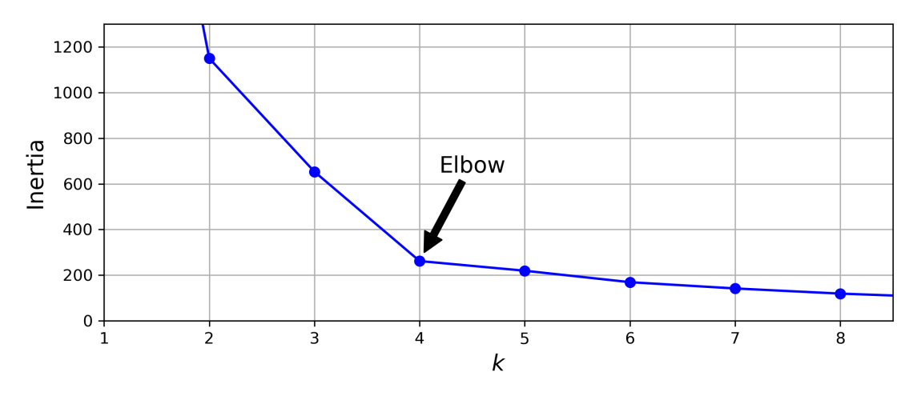
Finding the optimal number of clusters
The inertia is not a good performance metric when trying to choose 𝑘
because it keeps getting lower as we increase 𝑘.
Elbow method: plot the inertia as a function of 𝑘, the curve often contains an inflexion point called the elbow.

